Slide 1
Causal Learning Algorithms for Gene Expression
Sameera Boppana, Siddharth Mahesh, Rhea Verma

Slide 2
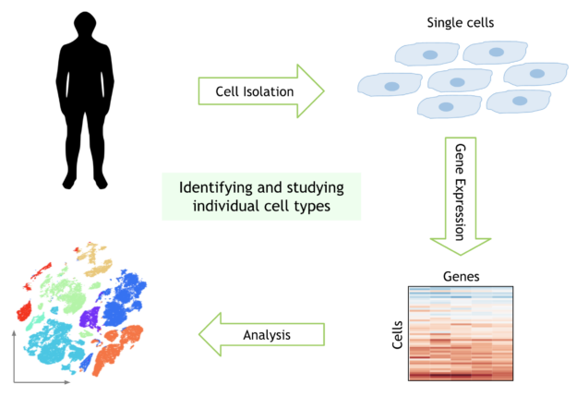
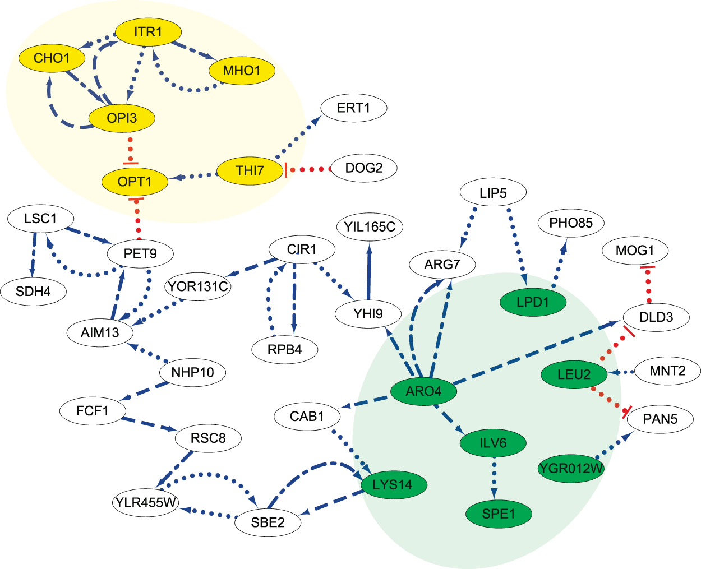
Gene Regulatory Networks
Upregulation or downregulation genes can affect other genes in network
Single Cell RNA Sequencing
Uses transcriptome (RNA) of individual cells to understand cellular heterogeneity

Slide 3
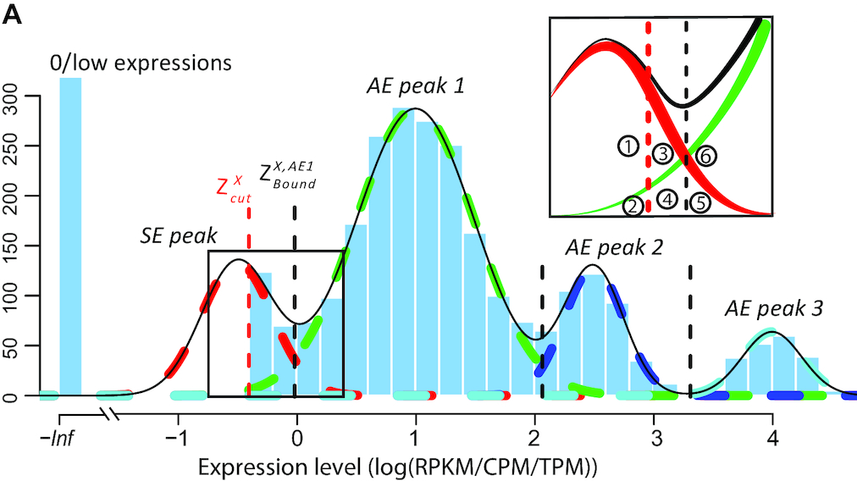
Left Truncated Mixture of Gaussians (LTMG)
Gaussian Mixture Models are multimodal
scRNA-seq data tend to be heavily left skewed and contain large number of zeros (little/no expression)
To handle observed zero/low expressions are truncated
Notes:
Gaussian Mixture models are multimodal with some number of gaussian distributions
Each of these gaussian distributions have their own mean and sd
Samples are assigned to one of the Gaussian Distributions based on the highest probability of being drawn from that particular sample
In single cell RNA-seq data, the data tends to be highly skewed to the left
The leftmost side of a Gaussian mixture model for scRNA-seq data represents the little/no expression data
Often times, the issue of a high left skew is solved by performing a log-transformation on the data to obtain more normally distributed data
However, with the large amount low/zero expression, the log-transformation is complicated
Therefore, the LTMG was developed. Truncation on the left of the Gaussian Distribution was applied to handle the low expression genes.
A cutoff was determined to represent the lowest expression level that can be reliably detected. Any expression values below this expression level are modeled as Left censored data and are truncated.

Slide 4
LTMG Flow
Step 1
Step 2
Step 3
Step 4
Input File (Matrix of Expression Levels between Genes)
Determine Cutoff point for Left Truncation
Left Truncation Performed
Expression State Data Frame Obtained and passed to Causal Algorithms
Notes:
Input: Matrix of Expression Levels between Genes
Can be 8x8 matrix → Expression levels between every combination of the 8 genes
Then Cutoff point of the smallest level of feasible expression determined
The left truncation is performed and any expression below the cutoff point are truncated
Output: an Expression State Data frame
This shows the expression of all the genes and the expression level of one gene can be compared to the expression level of another gene at the same time
This comparison and evaluation of the gene pairs is done through Causal Algorithms

Slide 5
Causal Models
An effective tool for understanding relationships (e.g. cause-effect) between several variables
In our case, these variables are various genes in a GRN
Goal: Use causal models to infer relationships between various genes in a GRN

Slide 6
Causal Models
Essentially four categories of “relationships” between a pair of nodes/variables (i.e. genes)
Latent confounders: two nodes X and Y are influenced by a common node Z.

Slide 7
Causal Models
Essentially four categories of “relationships” between a pair of nodes/variables (i.e. genes)
Partially directed edges (e.g. E o=> D): partially directed edges from node X to node Y indicate two possible relationships: X => Y or X ⇔ Y.

Slide 8
Causal Models
Essentially four categories of “relationships” between a pair of nodes/variables (i.e. genes)
Undirected edges (A = B): Two genes that have an indeterminate causality (X => Y, Y => X, or X ⇔ Y).

Slide 9
Causal Models
Essentially four categories of “relationships” between a pair of nodes/variables (i.e. genes)
Directed cause-effect relationships: X => Y is to be interpreted as “X causes Y.”

Slide 10
Method Verification
Predicted
Interaction
No Interaction
No Interaction
True Negative
(TN)
False Positive
(FP)
Precision - the fraction of inferred regulatory relationships that are correct
Recall - the fraction of regulatory relationships that are inferred
Actual
False Negative
(FN)
True Positive
(TP)
Interaction
Precision: TP / (TP+FP)
Recall: TP / (TP+FN)
Notes:
In order to evaluate the performance of this model, we will evaluate the following metrics in the next few weeks.. Precision quantifies the number of positive class predictions that actually belong to the positive class. Of the relationships that we predicted exist, how may actually exist? Recall quantifies the number of positive class predictions made out of all positive examples in the dataset. For all the possible interactions, how many did we correctly identify?
Similar studies have also used the, AUPRC which is calculated as the area under the PR curve. A PR curve shows the trade-off between precision and recall across different decision thresholds.

Slide 11
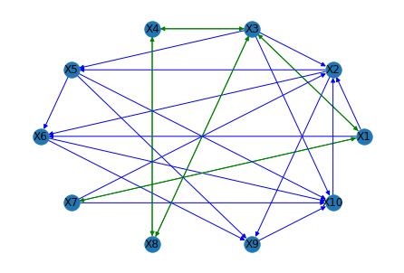
Demo

Slide 12
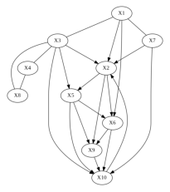
Sample Output From Demo

